Slide 1
Alta California Regional Center FY ’22-’24 Year-End Performance Contract Presentation
Notes:
Welcome & Introductions

Slide 2
On a yearly basis, Alta California Regional Center (ACRC) releases a Performance Contract that provides data and measures on topics that include where our clients live, ACRC’s compliance with Department of Developmental Services (DDS) standards, how well ACRC is doing at getting consumers working, and how well ACRC is doing at promoting service access and equity.
Regional Center Performance Contract Reports : CA Department of Developmental Services
Performance Contract and Year End Reports - Alta California Regional Center (altaregional.org)
Notes:
Today we will present and compare year-end 2022 and 2024 demographic, employment and Purchase of Service data as it relates to promoting service access and equity. The data is posted on ACRC’s website. Click the second link, if you would like to access during the meeting.

Slide 3
The DDS establishes contracts with regional centers that include specific, measurable, performance objectives, which are reviewed by the public on an annual basis. In accordance with W&I Code section 4629 (f)(1) Regional Centers must hold a public meeting, and we are happy to fulfill this requirement today.
Notes:
We value and rely on your input! The annual performance contracts are designed to help clients achieve quality of life, reach meaningful progress above current baselines, and develop services and supports to meet the needs of our clients.

Slide 4
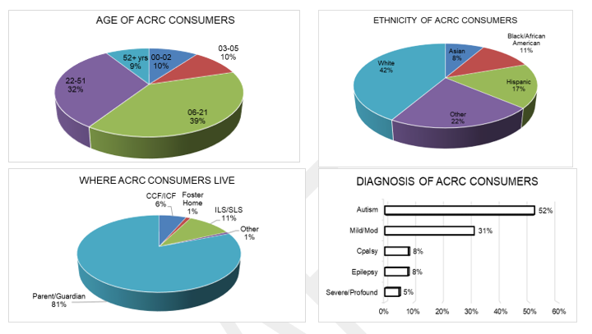
Let’s look at who we serve, these charts tell you about who ACRC clients are and where they live.

Slide 5
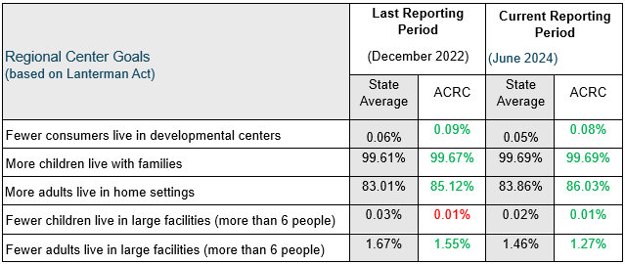
This chart tells you five areas where DDS wants each regional center to keep improving. The first column tells you how ACRC was doing last reporting period, and the second column shows how ACRC was doing at the end of fiscal year 2024. To see how ACRC compares to the other regional centers in the state, compare the numbers to the state averages (in the shaded columns).
Notes:
At ACRC, we want to improve every year, do better than the state average, and meet or exceed the DDS standard. As you can see in this report, ACRC has done well since the last reporting period.
Since 2022, fewer clients live in a developmental center, and more children and adults live at home with their families. We still need to decrease the number of clients living in developmental centers to meet the state average
Developmental Center: ACRC Continues to develop resources in the community (CPP or CRDP Plan) to transition clients that need specialized supports such as, medical, behavioral, forensic supports. Six new (EBCH.CCH. ARFPSHN) homes in development. Jordan Eller (how many clients transferred out of Long-Term Nursing to a community placement)
Since 2022 more children and adults live at home with their families
ACRC is focused on providing services in the family home with the goal of keeping our clients at home with families, if this is their choice.
For children, current and ongoing initiatives to support
Person centered planning
Coordinated Future Planning
Crisis intervention
Behavior services
Collaboration with Education
Partnership with Medi-Cal Managed Care Plans
Child Welfare – AB2083 work
Since 2022 Fewer children and adults live in large facilities.
ACRC has ONE child living in large (6+) facilities
New GHFPSHN
Since 2022 fewer adults live in large facilities. How many do we have?
current and ongoing initiatives to support
Person centered planning
Technology pilot
Housing Access Services
Coordinated Future Planning
Supported Living
Crisis intervention services
Behavior services
Coordinated Family Supports to work with client and parent (explain designed to ease burden on families and help develop plan and connect with generic resources
Partnership with Medi-Cal Managed Care Plans
Initiatives for Aging Clients
Advanced Care Planning
DSP Collaborative
Engagement with Community Stakeholders
Disability Housing Alliance
AAA Agencies
Housing Developers

Slide 6
In reviewing the breakdown of percentages, you will notice that there is no substantial increase or decrease in data represented. Although there is no substantial increase nor decrease, ACRC is continuously championing our efforts in reducing disparity, increasing access, and improving equity through targeted outreach
Percent of total annual purchase of service expenditures by individual’s ethnicity and age
Notes:
In reviewing the breakdown of percentages, you will notice that there is no substantial increase or decrease in data represented. Although there is no substantial increase nor decrease at this time, ACRC is continuously championing our efforts in reducing disparity, increasing access, and improving equity through the following measures:
Outreach: ACRC recognized that it was necessary to engage more with our diverse communities across all 10 counties by engaging in more outreach events. In 2022 ACRC participated in 37 events; in 2023 ACRC participated in 100 events; and as of September 2024, ACRC has engaged in 97 events. Our outreach participation has been staffed by none other than our diversely represented ACRC staff.
American Indian or Alaska Native/Native Hawaiian or Other Pacific Islander Target Population: Upon reflection of our POS data from May 14th, 2024 which states, “the American Indian/Alaska Native and Native Hawaiian and other Pacific Islanders are both less than one percent of ACRC’s client populations and also spend less than one percent of POS budget,” - we recognize that it is significant to delve further into our response as an organization to this targeted population, and increase our connection to serving these communities. In addition to engaging in outreach, as of 2024, ACRC has begun to engage in such efforts as Tribal Coaching calls with California Tribal Families Coalition, in order to become educated in how to engage the population further, and our Cultural Diversity Specialist has conducted annual outreach visitations to Tribal TANF – Shingle Springs in Placer County.

Slide 7
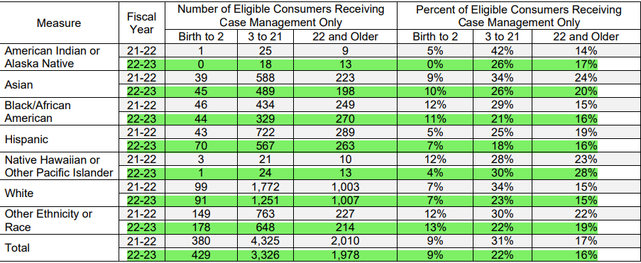
Number and percent of individuals receiving only case management services by age and ethnicity
Notes:
Enhanced Service Coordination Unit (In accordance with POS Data May 14th, 2024) – Reiterate Outreach Efforts:
“ACRC has six enhanced service coordination caseloads. These specialized caseloads were created by legislation in 2021 and have a max ratio of 1 SC to 40 clients. Clients eligible for this caseload have Low to No POS which means the cost of their services is under 2,000 annually and clients serviced in this unit either speak Spanish, Punjabi or identify as Hmong, Russian or African American. These were the groups with the highest number of Low to No POS clients. The six Enhanced Service Coordination SCs represent the culture or community they serve. This means the Enhanced Service Coordination SCs who serve individuals who speak Spanish, also speaks Spanish. This slide depicts, by percentage, the languages of the clients and families receiving Enhanced Service Coordination.”
“…The reduced caseloads allow SCs time to complete in-person, quarterly face-to-face visits, and time to build rapport and relationships. With Increased engagement, Enhanced Service Coordination SCs have time to educate and explore resources and navigate services. When individuals know more about services they ask for more services. To date, 293+ clients have been served on an Enhanced Service Coordination Caseload.”
ACRC also recognizes that there are instances in which some clients still request of SCs to be “case management only.” For reasons of being overseen by a case manager “Just in case,” and/or cultural customs and still needing additional education on what ACRC can do for said clients.

Slide 8
This chart demonstrates how well ACRC is doing on increasing consumer employment, compared to prior performance and statewide numbers.
*An N/A indication means that fewer than 20 people responded to the survey
Notes:
Since Employment First was passed in 2013, ACRC has made Competitive Integrated Employment for clients a priority. We can see an increase in average annual wages, which can partially be attributed to raises in minimum wage. Per EDD data, there was a decrease in total consumers with earned income. While we do not have access to where this data comes from, we are confident that the number of our consumers participating in employment continues to rise.
Will go into more info on next slide.

Slide 9
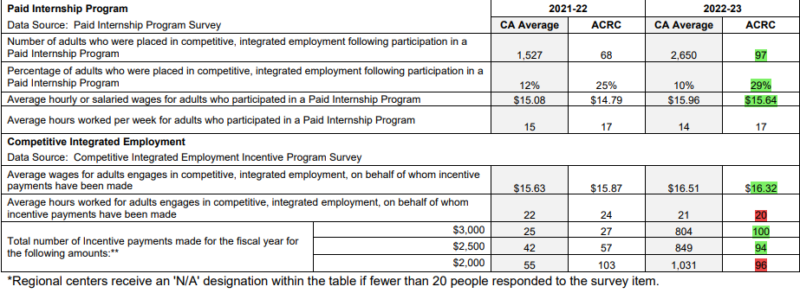
Notes:
During the 22-23 Fiscal Year, ACRC saw increases in number of consumers accessing the Paid Internship Program, as well as an increase in consumer who achieved CIE positions following Paid Internships. There was an increase in the number of 6 month and 12 month CIE incentive payments paid out to providers. These payments are for providers who have helped consumers achieve CIE positions and maintain their jobs in the community for the stated milestone periods.
Barriers to address- subminimum wage is officially ending as of Jan 1st. 2025, however most of our programs in ACRC’s catchment area have been phasing it out for some time. There is concern that these clients are at risk of losing their employment, however ACRC is working diligently with planning teams to ensure that a transition plan is in place for all clients to ensure that clients continue to have paid employment.
Outreach efforts-
Regular trainings are provided Case Management on employment services so that they know how best to support their clients.
We hold yearly vendor fairs for day and employment vendors to meet with case management to share information about their services.
Local Partnership Agreements (LPA), in our catchment area, in which we connect with DOR, school districts, and other community partners to ensure that there is a seamless transition from school and into employment.
LIFE Project- Collaboration with Sierra College to identify barriers and create a more streamlined pipeline from school to education to employment. LPA Summit
Outreach to providers to increase CIE/PIP/TDS services- CIE/PIP-33, TDS- about 42
Partnerships with Chamber of Commerce to build more employ partnerships- MealPro, for example.
CCP- new service designed to support clients within two years of graduating school or within 5 years of leaving a WAP or subminimum wage. Time limited- to support employment.
2 vendored, 6 in the process of being vendored.
In 2024, ACRC was one of two regional centers to receive extra funding for raising CIE numbers over a certain percentage (25%). Funding will be allocated to further outreach efforts

Slide 10
Questions?
Jennifer Bloom
Client Services Director
(916) 978-6572
jbloom@altaregional.org
Mechelle Johnson
Client Services Director
(916) 978-6653
mjohnson@altaregional.org
Dana Muccular
Client Services Manager, Enhanced Service
Coordination Unit
(916) 978-6667
dmuccular@altaregional.org
Carly Moorman
Client Employment Specialist
(916) 290-4183
cmoorman@altaregional.org

