Slide 1
American Rescue Plan Act (ARPA) Part C Initiative for Early Start:
Develop Culturally & Linguistically Sensitive Services
Updated December 2022

Slide 2
Who am I?
Lynn Arner
Early Childhood Specialist
Project Coordinator for ARPA Part C Initiative
Knowledgeable about Early Start
Passionate about Early Intervention
Excited about telling your story and supporting your work in Early Start

Slide 3

What can we accomplish?
Expand to support families’ unique needs for accessing critical services for their young children.
Increasing the availability of a provider network that reflects the cultural and linguistic diversity of the community
Expand your capacity to serve more children by offering incentives.
Notes:
Through this initiative we can better serve the families in Early Start. The goal is to serve culturally and linguistically diverse children and families.
We will do this by expanding our workforce and attracting students to the field. We will also offer incentives to serve families in remote and underserved areas.
We realize that it is difficult to reach favorable pay rates. We hope that the incentives provided by this pilot project will help to compensate you for the much needed work that you will provide for Early Intervention Services. We want to increase your capacity to serve those children and families we have not been able to serve.
Please note that translators, interpreters and psychologists are eligible for the stipends provided by this project.

Slide 4

Potential for Statewide Model
This initiative will roll out in our 10 counties.
We are creating a model for moving forward.
If this is successful, it can then be replicated Statewide.
Notes:
This project is being piloted in our 10 county region. Vendors serving families outside of our 10 county region cannot claim these stipends. We are creating a model for meeting the needs of our families and providing much needed services not currently being provided. This project has the potential for becoming a statewide model if we are able to show that these incentives attract more culturally and linguistically diverse staff and encourage service to children previously not being served. If we are successful, this project will be replicated Statewide and these incentives will continue for you in the future. This is our goal!

Slide 5
Outreach:
To address the shortage of Early Start providers
For attracting students to choose internships and eventual careers in Early Start
Notes:
As you all know, a shortage of Early Start providers exists, and there are more jobs available than there are providers. This shortage impacts families in accessing critical Early Start therapies for their infants and toddlers. With the recent changes in Early Start eligibility, which are bringing more children into the Early Start program, this shortage will become even more pronounced. Students trained in Early Start disciplines (speech and language pathologists, occupational therapists, physical therapists and behaviorists) have many choices in beginning their careers, and many are unaware of Early Start programs as they seek careers through the health care field. Therefore, outreach is a main focus of this initiative. So, we hope you will join us in attracting students to choose internships and eventual careers in Early Start.

Slide 6
Job Fairs and Community Events
Outreach to local universities, community colleges, and through job fairs to target undergraduates to establish initial interest.
Additional incentive to hire culturally and linguistically diverse staff who actively provide a minimum level of service hours
Notes:
This outreach will be done primarily through job fairs and community events.
We will outreach to local universities, community colleges, and through job fairs to interest undergraduates in the Early Start program and graduates in positions working in Early Start. Additional incentives will be given to new hires who are culturally and linguistically diverse, that match our identified language need. They can receive a sign-on incentive payment after completion of 6 months of actively providing a minimum of 60 POS service hours. Feel free to reach out to your alma mater to find interested interns. Some colleges have internship fairs which we would love to know about. I will be exploring all of these opportunities. This incentive is $2000/employee. We have 50 slots available in this project. ACRC must preapprove these stipends. You will see our form to report information on the potential hire prior to the claim.

Slide 7

How can you help?
Events
Let us know about community events or job fairs that would be valuable for us to attend.
Attend Events with us ($50 stipend)
Interviews
Showcase your passion for Early Start and the difference therapists can make in early intervention.
Families
Identify families who will share powerful stories of how they were helped by Early Start.
And those who will attend events with us ($50 stipend)
Notes:
We hope that you will partner with us in our efforts to get more interns and providers interested in working for Early Start.
Please let us know of any community events that would be valuable for us to attend to attract interns and Early Start providers.
Our outreach activities will also include showcasing the difference therapists can make in early intervention. We need all of you who are passionate about the work you do. Some of you will be interviewed about the difference therapists can make in early intervention and other stories that may influence students to consider a career in Early Start..
We will also need your help with identifying families who will share powerful personal stories.
If you are interested in attending these outreach events, please let me know. You will receive a $50 stipend as a small thank you and to cover your travel. Family members who attend will also receive a $50 stipend. If you know of a parent or other family member who can speak to the benefits of Early Start and may want to attend any of these outreach events, please connect me with them.

Slide 8
Incentives:
$11,000 for paid internships
Enhanced availability stipends for serving families in person in the following categories:
remote areas
underserved areas
service delivery time during non-working hours (evenings & weekends & holidays)
culturally and linguistically diverse populations
The internship period can be a trial for both the employer and the intern to see if this could be a good fit for permanent employment
Notes:
Further, we plan to incentivize current and new vendors to take on interns in an effort to advance the Early Start profession using the Paid Internship Program model. Some of you have mentioned that it is difficult to entice interns to work with you and help you with your workload. This program includes $11,000 for each internship. Our hope is to increase the availability of a provider network that reflects the cultural and linguistic diversity of the community. The internship period can be a trial for both the employer and the intern to see if this could be a good fit for permanent employment.
Additional incentives will be provided to you for serving families in the following categories:
remote areas stipend
underserved areas stipend
expansion of service delivery time during non-working hours (before 8am and after 4:30pm & weekends & national holidays)
And, as we mentioned, serving culturally and linguistically diverse populations.
As Part C intends, these services will be provided in person in the child’s natural environment rather than virtually.

Slide 9

Stipends
1 criteria = $200
2 criteria = $350
3+ criteria = $600
Based off an established POS authorization
Limited until funding exhausted
Maximum of 2 claims/month for the same client
Notes:
Here are the amounts being paid for each criteria and the maximum number per month for the same client is 2 claims per month.
Once you have billed for this service off an established POS, you can then submit the claim form. Jennifer will review this claim form with you later in this presentation.

Slide 10
Remote and Underserved Areas
Remote Areas: (45 minute or more drive for providers from their homes)
Placer County: Alta/Dutch Flat, Emigrant Gap, Colfax, Meadow Vista, Foresthill, Sheridan
Yuba County: Wheatland, Loma Rica, Brownsville, Dobbins, Oregon House, Beale AFB
Sutter County: Rio Oso, Nicolaus, Robbins, Pleasant Grove
Nevada County: North San Juan, Downieville, Smartsville
Yolo County: Esparto, Madison, Yolo, Knights Landing, Dunnigan, Arbuckle, Guinda and Brooks
Colusa County: College City (95912), Colusa (95932), Williams, Maxwell, Grimes
Underserved Areas (zip codes): Marysville, Olivehurst, Linda, Plumas Lake, Wheatland; Yuba City, Live Oak
95993, 95991, 95977, 95961, 95959, 95953, 95946, 95903, 95901, 95842, 95838, 95835, 95816, 95815, 95811, 95692, 95673, 95660
Notes:
Families in remote areas are not getting their needs met. We realize that the barriers include: travel time, your lost time due to appointment cancelations or showing up and no one is home, and lack of mileage reimbursement. You will receive a stipend for serving families in these areas which are remote or underserved. This list is not comprehensive so please reach out if you have any questions on specific areas.

Slide 11
Expansion of Service Delivery
Nonworking Hours (evenings, weekends, & holidays)
In person in natural environment
Notes:
Families report that one of the challenges they face in navigating and receiving Early Start services is finding time to access services for children outside of their work hours. Single and working parents, particularly hourly wage workers, are more likely unable to leave their jobs to attend Early Start sessions that are offered during typical workweek hours (M-F, 9-5). In order to serve families with working parents, you will receive $ for serving families during non-traditional working hours such as evenings or weekends or national holidays.
While remote/telehealth services can be effective, this model is not conducive to the dynamics of all families. Many families are seeking in-person therapies for their child, as well as support and parent coaching in their natural environment. These stipends are reserved for in person services only. For example, if you are serving a client during nonworking hours in person or you have an in person visit and you are providing translation or interpreter services for this visit, a claim may be submitted for these visits. Office visits are not eligible for this stipend.

Slide 12
Cap on Claims per Vendorization
50 claims per vendorization
Notes:
Due to limited funding for this one-time program, and the demand from varying geographical areas, populations, and the intention to expand provider capacity in different regions, these stipends are limited to a total of 50 stipend payments per vendorization. Without a cap, per vendor, many will not be able to participate, as funding would be maxed out. The intent of the project is to expand our services and reach families in ways we were not doing prior to this funding opportunity. Please think carefully about clients who you can now serve.

Slide 13

How will you get paid?
Complete a stipend claim form
Payments will be received no later than December 2023

Slide 14
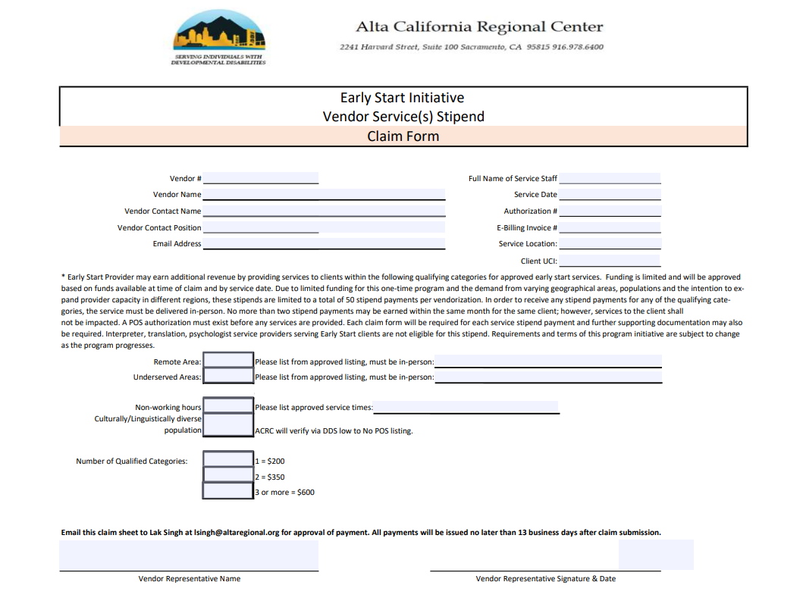

Slide 15
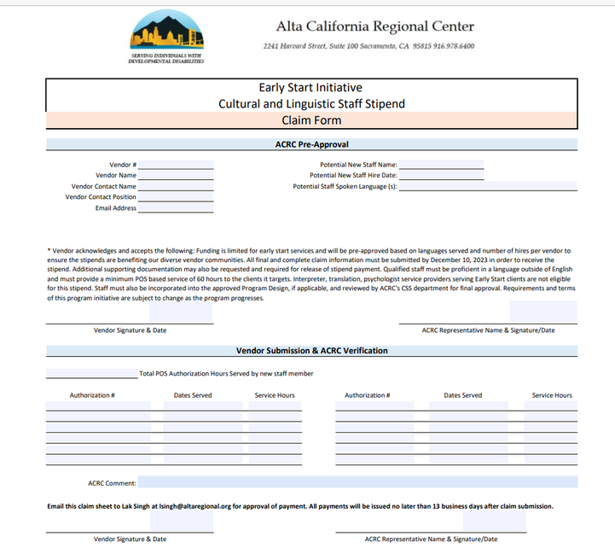

Slide 16
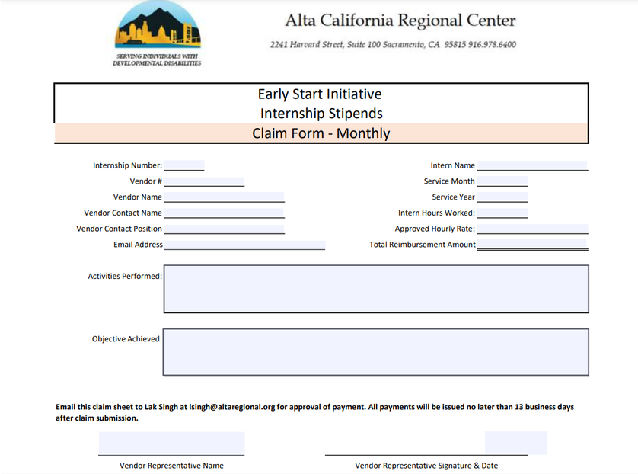

Slide 17

Notes:
We will be sending you our updated FAQs. Thank you for all of the questions we have received. Please read the new FAQs if you have any questions. As always, you are welcome to reach out to me or Jennifer with any questions that still remain. We will email these updated FAQs along with the link to this video.

Slide 18

Lynn’s Contact Info
lynnarner.consultant@gmail.com
530-902-5097
Notes:
Because I am a contractor with ALTA, I am providing you with my contact information here. Please feel free to reach out to me any time.
Thank you!

