Slide 1
Service Navigator
Program
Funding for this project is provided by the Department of Developmental Services.

Slide 2
This project is a collaboration with:
Alta California Regional Center and WarmLine Family Resource Center to provide navigation services to clients and their families from the following targeted populations:
17- 40 years old, (0-3 starting July 1) and
Reside in Sacramento, Placer or Yolo Counties and
Spanish Speaking or African American (Russian speaking starting July 1)

Slide 3
The goal of this project is to increase access and utilization of ACRC services by the target populations.

Slide 4
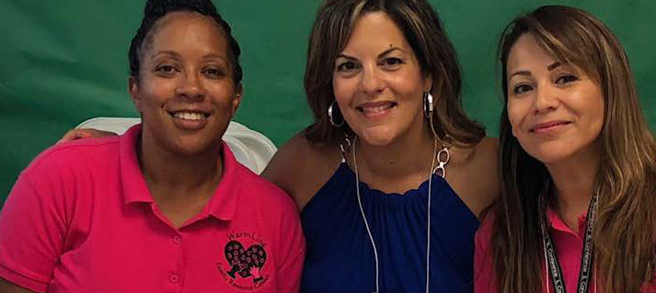
LaKeisha – African American Clients (far left)
Violeta – Spanish speaking families (far right)
Valerie – Russian speaking families (photo soon)

Slide 5
The Service Navigators will engage the clients and their families with the following objectives:
Establish a relationship and gain trust to authentically engage clients and families to get the supports and services that they need based on their preferences and vision.
To ensure that the client and family understand the services that are available and offered through ACRC and the impact of the services on their lives.
Create an individualized Person Centered Plan to assist in identifying services and supports that meet the vision, dreams, desires and interests of the client. The Navigators will work closely with the client, family and regional center service coordinator to identify the services and supports to turn the vision into reality.
Identify barriers to access and utilization of services and share this information with the regional center.
Assist with navigating generic services, when and if appropriate.

Slide 6
HOW TO REFER A CLIENT?
Alta Service Coordinator (SC) will identify clients who match the criteria for the Service Navigator Program:
18- 40 years old (0-3 years old starting 7/2020)
and
Reside in Sacramento, Placer or Yolo Counties
and
Spanish Speaking or African American (Russian speaking starting 7/2020)
The SC will fill out a referral form and email to Kelly@warmlinefrc.org
Within 7 days, an email will be sent to the SC with the name and contact email of the Service Navigator. The Service Navigator may call the SC to get more information about the client’s and family’s barriers or needs.
The Service Navigator will contact the family within 10 days to schedule a time to review the program.

Slide 7
SERVICE NAVIGATION
The Navigators will work with clients and their families to prioritize needs and educate them on the regional center systems.
The goal of this project is to increase access and utilization of ACRC services and to identify barriers to culturally appropriate services.
Collaboration with the regional center is the key to success!

Slide 8
How it Works:
At the first meeting the Navigator will review the program and have the client and family complete a pre-survey. More importantly, the Navigator will take the time to listen to the client’s and family’s concerns and dreams and to build a trusting relationship.
If client and family approves, navigation services will begin, including
Educate clients and families about regional center and generic services.
Generic service assistance - the case management team will determine if assistance can be provided and the scope of assistance.
Assist families in transitioning their adult child from special education services to regional center adult services.
  A Person Centered Plan (PCP) will be developed with input from key people.
In collaborations with the SC, assist the client in identifying appropriate services and programs that align with the PCP.
A post-survey will be given to the client and family to measure the increase in knowledge about services.

Slide 9
Questions?

