Slide 1
WELCOME, Herman Kothe Alta California Regional Center Training Manager Cindy Le formerly Alta California Regional Center Employment Specialists currently Alta California Regional Center Home and Community Based Services Specialist

Slide 2
The Regional Center System and the history of employment first legislation, policies and services
Presented by SCDD, DOR, ACRC and FNRC

Slide 3
Learning Objectives
Gain a familiarity with the regional center system
Understand eligibility criteria and how to qualify for regional center services
Learn how to access regional center services and supports
Increase knowledge of employment options

Slide 4
Regional Centers
Regional Centers are the agencies through which eligible individuals with intellectual and other developmental disabilities receive case management services to support them to participate and contribute as valued members of their communities and achieve their life goals.
Regional Center System
Notes:
This statements speaks to the vision/mission of our agency.
A community where individuals with intellectual and/or developmental disabilities are valued members who are treated with dignity and respect.
Law is referred to as Lanterman Act beginning with Welfare and Institutions Code section 4400
W&I Code Section 4646(a) states in part regional center responsibilities are to Promote community integration, independent, productive, and normal lives and stable and healthy environments.

Slide 5
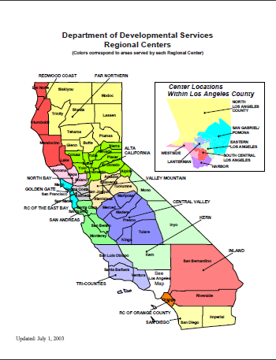
Each Regional Center is a private, non-profit corporation
Eligibility transfers across the state
Notes:
21 Regional Centers throughout the state.
Alta covers 1the most counties (10).
3rd largest in both population and geographic area.

Slide 6
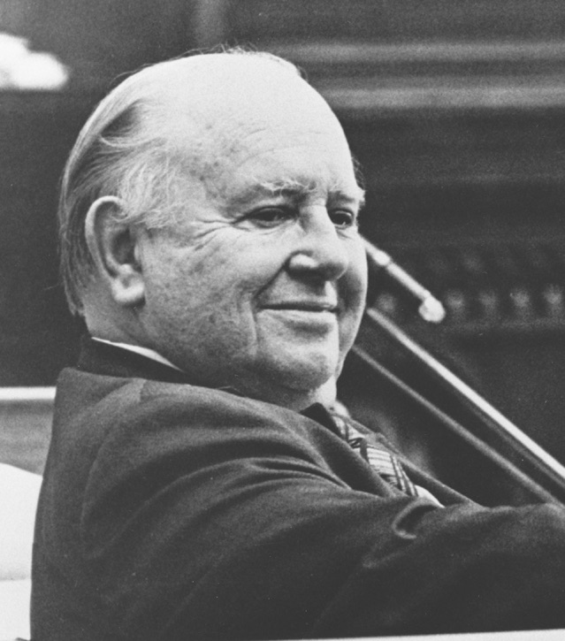
A little bit of history… The Lanterman Act
A child was born with a disability…
Keep children at home with no support
Send them to state run hospitals
Legislation passed in 1965 to shift public resources from institutions to Communities
The 21 non-profit regional centers serve as local resources to provide:
Assessment of Eligibility and Diagnosis
Service Coordination
Notes:
In existence over half a century. Challenges with aging population and aging support system. CMS rules.

Slide 7
The Lanterman Developmental Disabilities Services Act
The Lanterman Act provides for the coordination and provision of services and supports to enable people with intellectual and developmental disabilities to lead more independent, productive, and integrated lives. Additionally, the Early Start Program provides services to infants and toddlers at risk of having a developmental disability. The Department carries out its responsibilities through contracts with 21 community-based, non-profit corporations known as regional centers, as well as through state-operated homes and facilities.
Notes:
This statements speaks to the vision/mission of our agency.
A community where individuals with intellectual and/or developmental disabilities are valued members who are treated with dignity and respect.
Law is referred to as Lanterman Act beginning with Welfare and Institutions Code section 4400
W&I Code Section 4646(a) states in part regional center responsibilities are to Promote community integration, independent, productive, and normal lives and stable and healthy environments.

Slide 8
The Regional Center System: Serves about 400,000 people statewide
Is unique to California
Are “Voluntary” agencies
Administer Two Programs:
Early Start Program- provides early intervention services to infants and toddlers, birth to 3
Regional Center- provides services to individuals age 3 and above throughout their lifespan
Notes:
Entitlement program = No wait list for case management and development of service plan.
Womb to tomb.

Slide 9
Regional Centers are contracted and funded by the State Department of Developmental Services (DDS)
Budget
Operations
About 11%
POS
About 89%
Not a State Agency
Notes:
North of 6 billion system wide for entire state including SDCs.
Alta’s budget is north of ½ billion, with over 85% designated for direct service.

Slide 10
Association of Regional Center Agencies (arcanet.org)

Slide 11
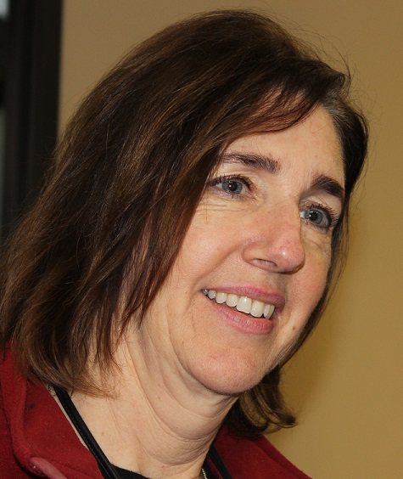
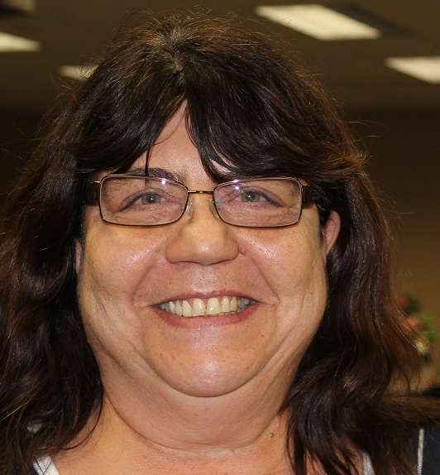
Service Coordinators
Assigned caseloads
Main point of contact for
Clients and family
Notes:
Caseloads average 80 – 90 clients.

Slide 12
Plans of Support
Individualized Family Service Plan (IFSP)
For Infants and toddlers, birth to age 3
Individual Program Plans (IPP)
For children age 3, youth and adults
Notes:
Plans are fluid documents. ACRC assesses needs, determines what’s available in the community or within the natural supports of the person, and funds what doesn’t exist…regional centers are safety nets so to speak.

Slide 13
Support Plans
Goal/Outcome
Generic
Agency
Natural
Support
Vendor $$
Notes:
Assessment
Goals
Objectives
Services and Supports

Slide 14
Association of Regional Center Agencies (arcanet.org)

Slide 15
Review/Monitor Support Plans
Quarterly
Residential (3+)
Independent Living/ Supported Living with support (18+)
Semi-Annually
Early Start (0-3)
Specialized Children’s Services (3-17)
Annually
Children’s Services (3-17)
Adults (18+)
Notes:
Rule of thumb:
Monitoring frequency is primarily based on living arrangement:
Family/relative or guardian monitored annually
All others quarterly

Slide 16
What do Regional Center Services Cost?
There is no charge for assessment of eligibility, diagnosis and case management
For some parents of a child birth through age 17 who are not eligible for Medi-Cal:
Annual Family Program Fee (AFPF) of $200 or $150 or $0
Family Cost Participation Program (FCPP) share of cost 0 to 100% for respite and day care services
Parental Fee Program share of cost % for 24-hour out-of-home placement in a regional center funded setting
Notes:
2005 FCPP
2009 Prohibited services
2011 AFPF

Slide 17
Regional Center (Lanterman Act Eligibility) Ages 3 and Older

Slide 18
Conditions of Eligibility Lanterman DD Act (AB 846)
Intellectual Disability (ID)
Cerebral Palsy (CP)
Epilepsy
Autism
“5th Category” …other disabling conditions found to be closely related to ID or to require treatment similar to that required for ID individuals
Notes:
Changed from MR to ID after DSM-5
<1960 classifications: idiot (2), imbecile (2-7), moron (7-12)

Slide 19
Conditions of Eligibility
In addition… “Such a disability originates before an individual attains age 18, continues or can be expected to continue indefinitely, and constitutes a substantial disability for such individuals. Substantial disability means a condition which results in major impairment of cognitive and/or social functioning.”
Notes:
TBI example

Slide 20
Substantial Disability
A condition which results in major impairment of cognitive and/or social functioning…
The existence of significant limitations in 3 or more of the following areas:
Receptive & Expressive
Learning
Self-care
Mobility
Self-direction
Capacity for independent living
Economic self-sufficiency

Slide 21
Developmental Disability shall not include…
Disabling conditions that are:
Solely psychiatric disorders
Solely learning disorders
Solely physical in nature

Slide 22
Who Gets Referred???
All ages
Disability must occur prior to age 18, but referrals can be made at any age
All socio-economic backgrounds
Culturally diverse population
Citizenship is not a requirement

Slide 23
The Intake Process How It Works
Step 1 Request services
Generally best for the family or person to make first contact- can’t act unless parent or legal guardian consents
Step 2 Initial interview
Scheduled with an Intake Specialist
Step 3 Specialists’ assessments to determine eligibility
120 calendar days time line

Slide 24
If Found Eligible…
Clients are assigned a Service Coordinator to develop an Individual Program Plan (IPP) within 60 days
If determined ineligible…
Referrals to other resources
Opportunity to appeal
ACRC will always review new information

Slide 25
ACRC MUST exhaust Generic and Natural Supports first!
Examples of Generic Resources Accessed by Families for Children
School Districts
Department of Rehabilitation (DOR)
Medi-Cal
In Home Supportive Services (IHSS)
California Children’s Services (CCS)
* Also required to explore Private Medical Insurance

Slide 26
Employment First Law
On October 9, 2013, Governor Brown signed AB 1041 (Chesbro) into law, establishing an "Employment First Policy" in the Lanterman Developmental Disabilities Services Act. In keeping with the Employment First Policy, the Work Services Program addresses the employment needs of persons with developmental disabilities. The Work Services Program provides work and community integration opportunities through Supported Employment Programs (SEPs). These programs are available to persons who are Regional Center clients.

Slide 27
Federal Law
On July 22, 2014, the Workforce Innovation and Opportunity Act (WIOA) was signed into law. This landmark federal legislation makes significant changes to vocational rehabilitation and independent living programs in California and across the United States. WIOA, which replaces the Workforce Investment Act of 1998 and amends the Rehabilitation Act of 1973, is designed to help job seekers access employment, education, and support services to succeed in the modern labor market.

Slide 28
Regional Center Employment First Policies
Alta California Regional Center's Employment First Policy
Far Northern Regional Center's Employment First Policy

Slide 29
Senate Bill 639 signed into law
Over 12,000 Californians with disabilities work for less than minimum wage in segregated settings. Some workers with disabilities currently earn less than $2 per hour doing menial work. Senate Bill 639 (Durazo) ensures all workers earn $15 per hour and can become financially independent. It creates a path that transitions workers with disabilities from segregated settings to integrated settings and allows workers with disabilities to earn a real wage and work alongside their colleagues. Several other states and cities have already ended paying people with disabilities less than minimum wage. It is time for California to do the same.
SB639 | SCDD (ca.gov)

Slide 30
What Does the Bill Do?
As of January 1st, 2022, no new 14(c) certificates may be awarded, meaning only providers who already had a certificate can continue to pay subminimum wage past January 1st of next year.
The second significant milestone is January 1st of 2025. This is the cutoff date where subminimum wage will be completely prohibited in the state.

Slide 31
Embracing Employment First Philosophy
Competitive Integrated Employment with Tom Pomeranz Part 1 – YouTube
Competitive Integrated Employment with Tom Pomeranz Part 2 - YouTube

Slide 32
Employment Resources: Supported Employment
Supported Employment (SE) Services through the Department of Rehabilitation (DOR) and regional centers can be provided either through the vocational rehabilitation program or the Habilitation Services Program (HSP). SE services are aimed at finding competitive work in a community integrated work setting for persons with disabilities who need ongoing support services to learn and perform the work. SE placements can be individual placements, or group placements (called enclaves), or work crews, such as landscaping crews.

Slide 33
Employment Resources: Supported Employment Continued
Support is usually provided by a job coach who meets regularly with the individual on the job to help the individual learn the necessary skills to work independently. As the individual gains mastery of the job, the support services are gradually phased out.

Slide 34
Department of Rehabilitation (DOR)
The Department Of Rehabilitation DOR is the main vocational rehabilitation program SE service provider for adults with developmental disabilities. However, if the DOR is unable to provide services due to fiscal reasons, the regional center may be able to help individuals served get a job by funding SE under the HSP, or by referring them to other programs that provide SE-like services if these services are available in their area.

Slide 35
Employment First
The California Department of Rehabilitation (DOR), California Department of Education (CDE), and California Department of Developmental Services (DDS) have entered into a new agreement consistent with the Employment First Policy and other laws to make employment in an integrated setting, at competitive wage, for individuals with Intellectual Disability and Developmental Disabilities (ID/DD) its highest priority.
Competitive Integrated Employment Roadmap for Consumers (altaregional.org)

Slide 36
New Employment Resources
Effective July 1, 2016, two significant programs were enacted through California's State Legislature to increase competitive, integrated employment for those with developmental disabilities, pursuant to the Welfare and Institutions Code, Sections 4870 and 4870 (d-g).

Slide 37
Competitive Integrated Employment (CIE) Incentive Payments
To encourage regional center service providers to increase placement and retention of regional center consumers in competitive, integrated employment.
$2000- 30 days placement
$2500- 6 months
$3000- 12 months

Slide 38
Paid Internship Program (PIP)
To increase the vocational skills of consumers and create a pathway to a competitive integrated job
As of July 1, 2021:
1,040 hours per internship year
Can cover employer-related costs associated with the internship (workers comp)
Can have multiple internships as long as it does not go over the 1,040 hours

Slide 39
Employment First
The State of California Developmental Disabilities System: Employment Data Dashboard presents data on how well California is doing in implementing California's Employment First Policy.

Slide 40
Thank you for your time today!

Slide 41
Presenters

