Slide 1
Community resource Development Plan FY 19/20
Board Presentation – January 23, 2020
John W. Decker, MSW – Director of Community Services and Supports

Slide 2
What is CRDP?
When DDS determines that sufficient funding has been appropriated and reserved for a fiscal year for purposes of the Community Placement Plan (CPP) – to allocate the remaining CPP funds to regional centers for purposes of community resource development to address services and supports needs of consumers living in the community.
DDS Goals:
Goal One: Expand the availability, accessibility and types of services and supports to
meet current and future needs of individuals and their families in the community.
Goal Two: Develop systems to ensure that quality services and supports in the least
restrictive environment are provided to individuals in the community.
Goal Three: Develop services that are person-centered and represent the diversity of
the regional center’s catchment area.

Slide 3
How to make a CRDP request to DDS
Outreach
Stakeholder Meeting
Proposal
Support data (i.e., consumer growth trends or changes in consumer demographics or service needs)
Priorities posted on our website (2 weeks before submission)

Slide 4
Request to DDS - $1.5 million
SHRA/McCormack Baron and Salazar
Mutual Housing/ Brilliant Corners
Mercy Housing

Slide 6
What will our $1.5 million pay for?
Predevelopment
Acquisition
New Construction

Slide 7
What does our $1.5 million buy?
Sacramento Housing and Redevelopment Agency Director has approved 15 site based vouchers for ACRC clients. ACRC clients pay 1/3 of their monthly income = Rent and utilities
Only eligibility requirement is an ACRC client must be eligible for a Section 8
12 one-bedroom apartments
3 two-bedroom apartments
10 units will be fully ADA compliant “special needs”
5 units will be “visitable” by a person in a wheelchair. Flat thresholds, either ground floor or elevator units
$100,000 = 1 housing unit for ACRC clients
55 year restrictive covenant

Slide 8
Location
Property for ACRC clients will be in the building on the corner of Richards Blvd. & Dos Rios St.

Slide 9
Old Dos Rios Housing Project
Built in the 1940’s
218 Units

Slide 10
487 total housing units will be constructed, including one-for-one replacement of the original 218 public housing units.
Unit types include townhouses, garden apartments, and 3 to 4-story apartment buildings.
New and existing streets will connect the current site to the surrounding neighborhood.
All units are designed to meet the space and storage requirements of today’s households, and incorporate energy efficiency and water-saving features.
The site will include photovoltaic (solar) systems and electric-vehicle charging stations.

Slide 11
Looking Southeast

Slide 12
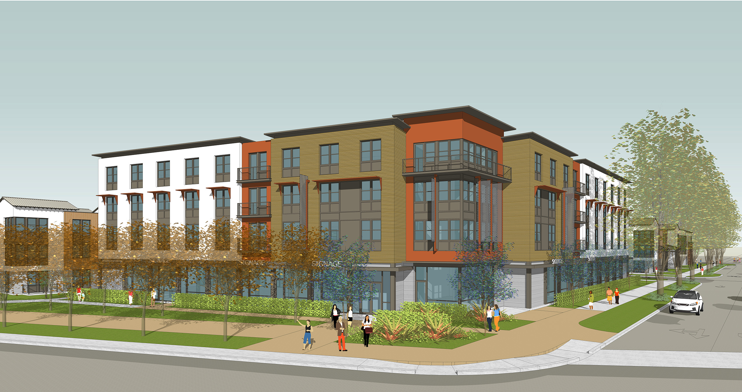

Slide 13
New Light Rail Station

Slide 14
Looking Northwest

