Slide 1





National Core Indicator (NCI)
Public Meeting 2025
Notes:
Jen

Slide 2



National Core Indicators
W&I Code §4571(h)(1)…
…requires that each regional center annually present data collected from NCI surveys at a public meeting of its governing board to assess the comparative performance of the regional center and identify needed improvements in services for consumers, including, but not limited to, case management services.
Share suggestions:
Please submit comments in Chat
ncifeedback@altaregional.org
National Core Indicators - CA Department of Developmental Services
The National Core Indicators (NCI) Surveys give individuals with intellectual/developmental disabilities (I/DD) and their families the opportunity to voluntarily and confidentially share their experiences on access to and use of regional center and community services.
The NCI Survey is used by the California Department of Developmental Services (DDS) to assess performances in services and supports provided to people with developmental disabilities.
Survey responses help the regional centers see what they are doing well and what they can improve.
Notes:
Jen
Purpose of NCI
How well Alta is doing
Comments in Chat
Link to raw data

Slide 3

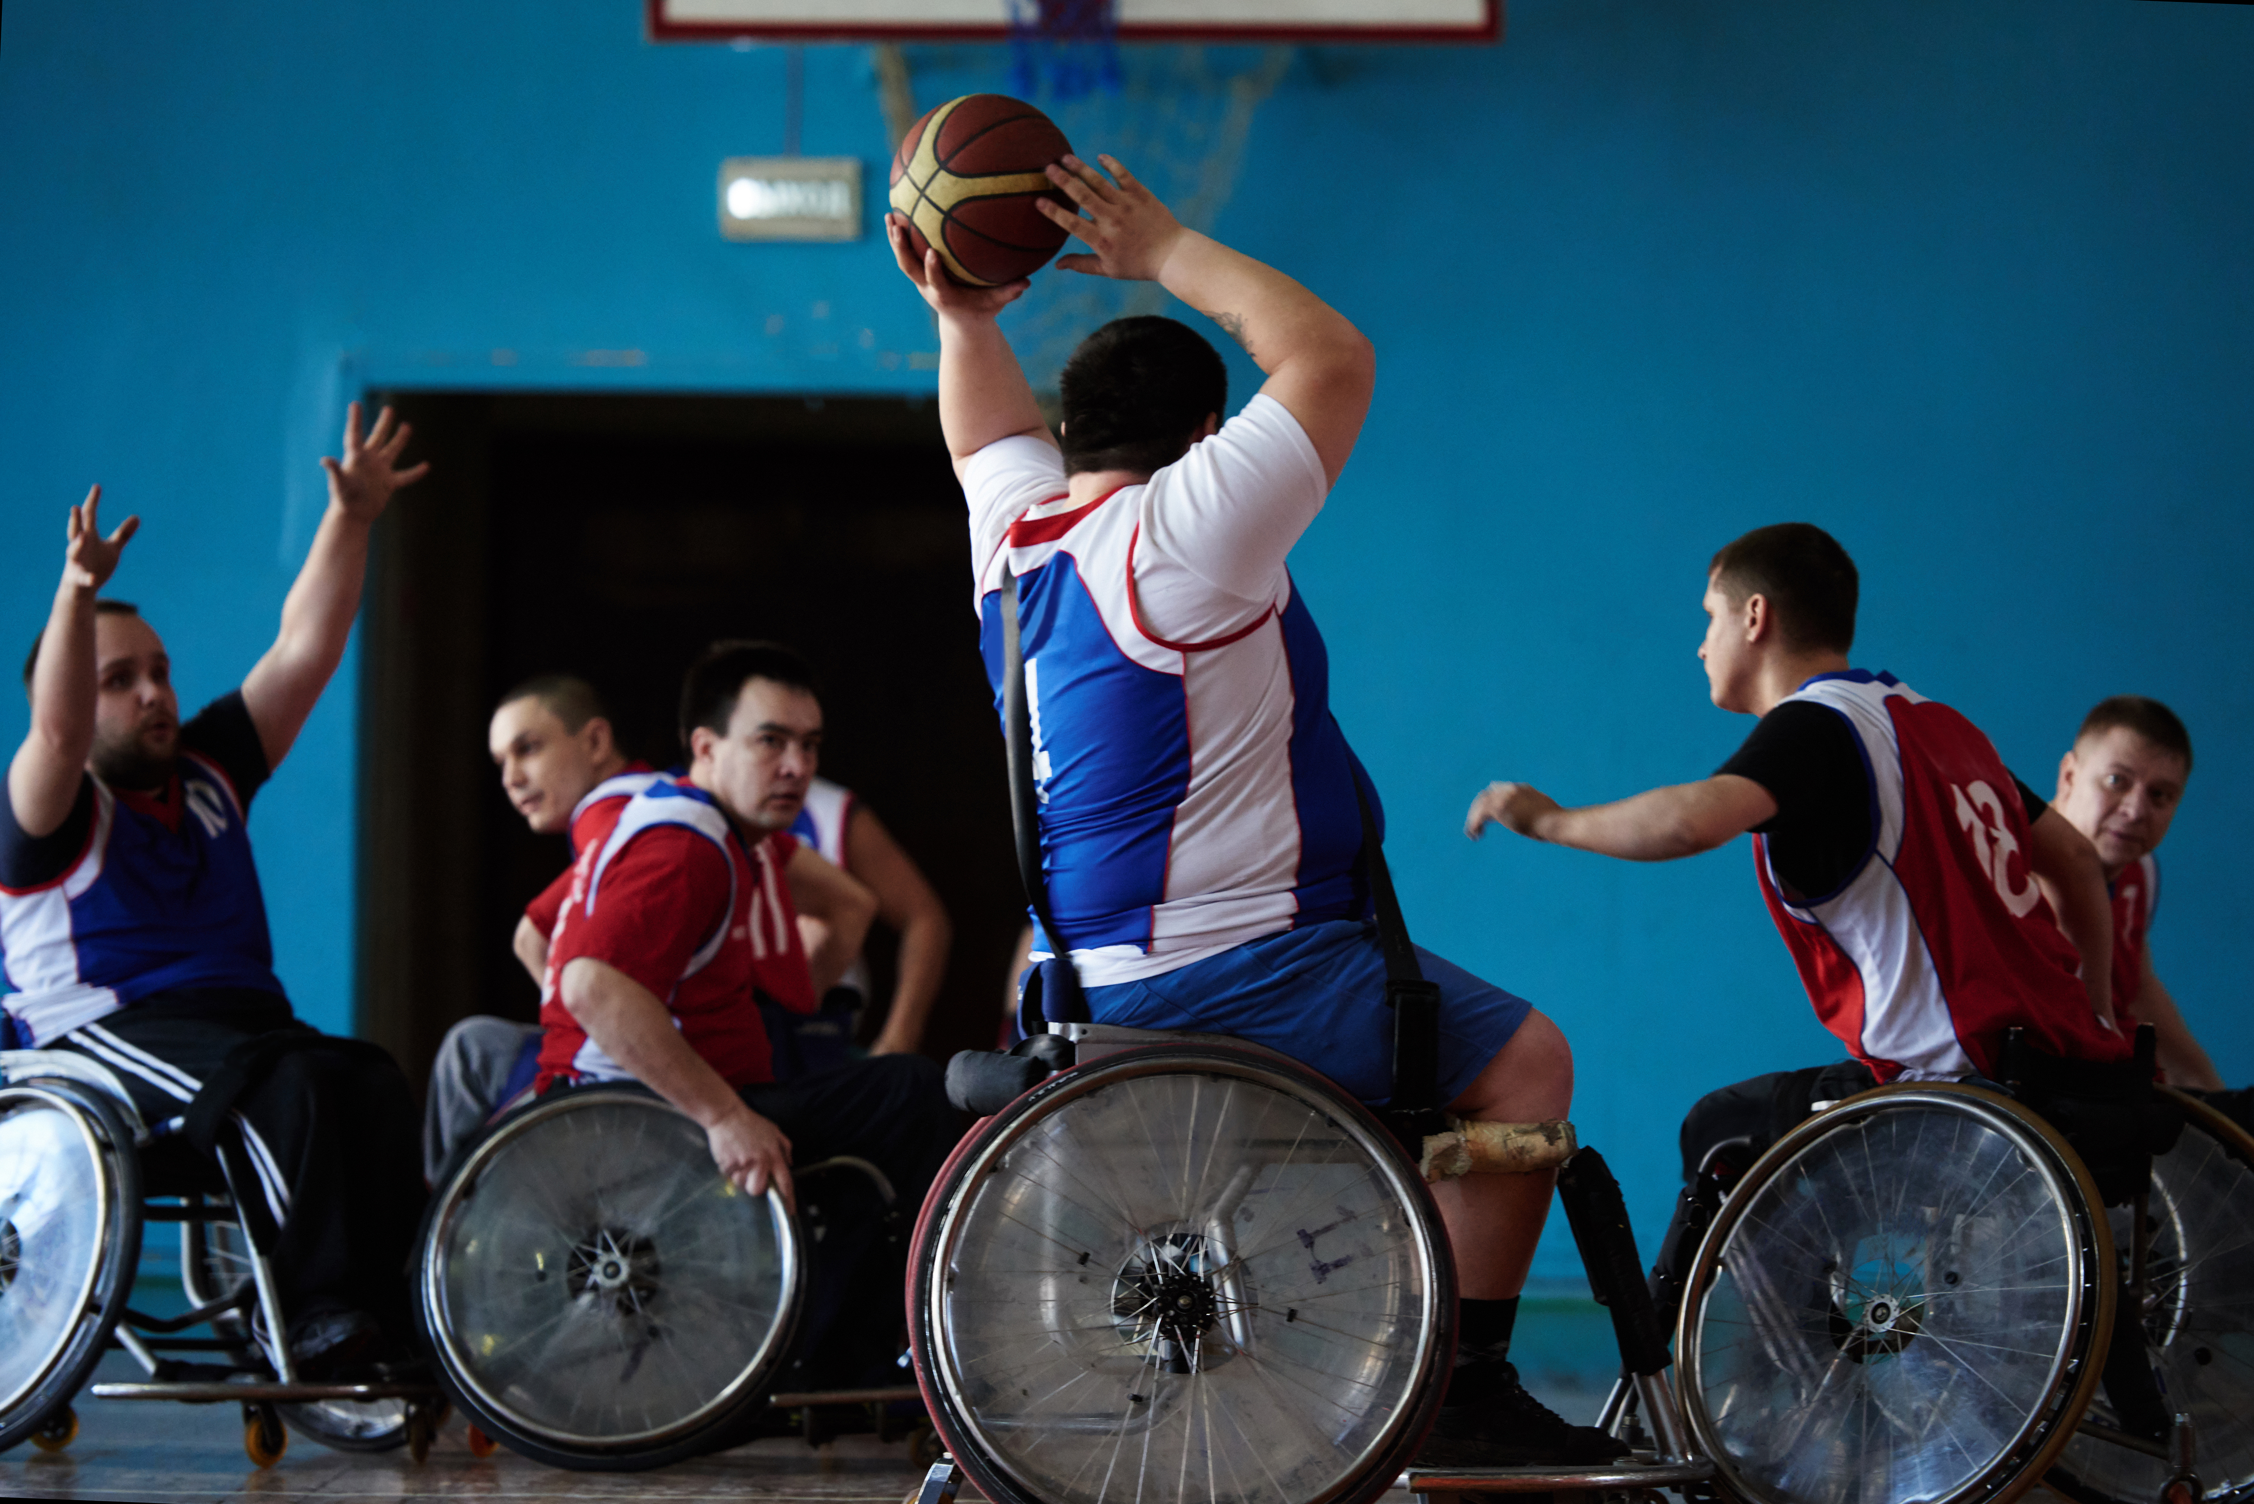
Adult Family Survey
The Adult Family Survey is a written survey that is completed by families of an adult (age 18 and over) who lives with them and receives at least one service from a regional center, in addition to case management.
Child Family Survey
The Child Family Survey is a written survey that is completed by families of a child (ages 3-17 years old) who lives with them and receives at least one service from a regional center, in addition to case management.
Family Guardian Survey
The Family Guardian Survey is a written survey that is completed by families and conservators of individuals (age 18 and over) who live in a community placement setting, and receive at least one service from a regional center, in addition to case management.
Notes:
Jen

Slide 4
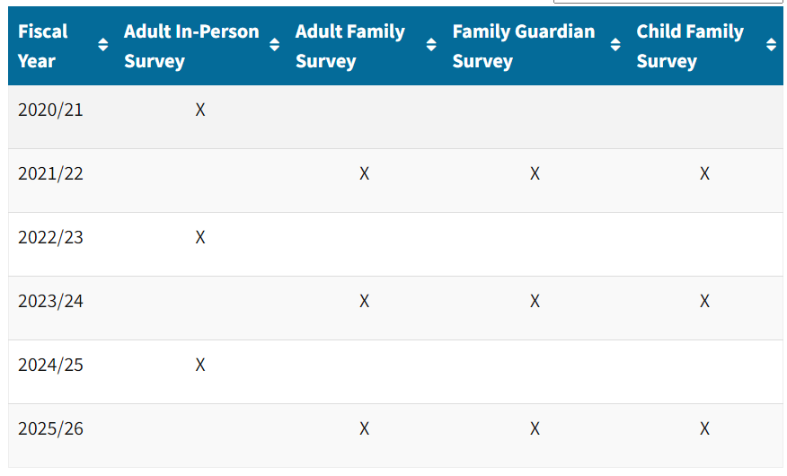
Review of Survey Cycle
Notes:
Jen
The Survey Cycle, as currently set, operates as follows.

Slide 5
Demographics | This section provides a detailed profile of individuals with intellectual and developmental disabilities (ID/DD) and their families, including age, gender, health conditions, race, ethnicity, and preferred language. It highlights diversity across disabilities, communication methods, and household structures. The data help regional centers understand who they serve, and tailor supports accordingly
Information and Planning | This section evaluates how well families receive, understand, and use information to plan services for their loved ones. It explores case management communication, clarity of materials, and the availability of planning assistance for future needs such as housing, employment, and legal matters. Results may reflect whether families feel informed, respected, and supported in the planning process.
Access and Delivery of Supports | This section measures how easily families can reach support workers, service coordinators, and needed resources. It also addresses reliability, cultural responsiveness, and adequacy of services like respite, technology, and internet access. The data attempts to gauge whether services are delivered consistently and adapt to changing family needs.
Choice, Decision-Making, and Control | This section examines family autonomy in choosing or managing service providers and staff. It looks at the extent to which families can select case managers, coordinate support teams, and influence service decisions. Findings are intended to illustrate the degree of empowerment and flexibility families experience within the service system.
Community Participation | This section explores inclusion and social engagement for family members with disabilities. It covers barriers such as transportation, cost, and stigma, as well as opportunities to participate in community activities or family-to-family networks. The data underscores how social connections and access to community resources influence quality of life.
Health and Safety | This section reviews access to healthcare, dental, and mental-health services, along with medication management and emergency preparedness. It examines whether providers understand disability-related needs and how families handle crises or report abuse or neglect. The responses indicate overall safety, health awareness, and system responsiveness in times of need.
Satisfaction | This section captures family perceptions of service effectiveness, quality, and impact on financial and emotional well-being. It asks whether supports have improved the family member’s life and reduced expenses. The findings provide a holistic view of satisfaction and perceived value of services received.
California-Specific Questions | This section focuses on state-level measures such as out-of-pocket costs, language accessibility, cultural respect, and emergency preparedness. It highlights how regional centers communicate in preferred languages and support families’ planning for natural disasters. These items provide localized insight into equity, accessibility, and readiness across California’s service network.
Notes:
Mechelle
Highlight differences year over year.

Slide 6
Adult Family Survey (AFS)
Survey Demographic Statistics
x̄ Age = 33.5
Gender Male = 63% Female = 37%
Family Member Communication Spoken = 83% Gestures/Body Lang. = 10% Sign Language = 2% Comm Aide/Device = 2% Other = 4%
Preferred Lang. English = 76% Spanish = 14%
Respondent Relationship Parent = 88% Sibling = 6% Spouse = 0% Grandparent = 2% Other = 4%
Sample Size: 14131 Responses
ACRC Demographic Statistics
x̄ Age = 33.5
Gender Male = 65% Female = 35%
Family Member Communication Spoken = 84% Gestures/Body Lang. = 9% Sign Language = 1% Comm Aide/Device = 2% Other = 4%
Preferred Lang. English = 87% Spanish = 5%
Respondent Relationship Parent = 88% Sibling = 6% Spouse = 0% Grandparent = 2% Other = 4%
Sample Size: 1074 Responses
2023/ 2024
Notes:
Elijah
Comparing the Survey Demographic Statistics to the ACRC Demographic Statistics, we see the two groups align closely on age, gender, communication style, and language preference, with only minor differences—such as a slightly higher use of sign language and Spanish among survey respondents statewide—that are not statistically significant at these volumes. However, the ACRC Demographic status shown here of 1,074 responses is a small fraction of our full client population of 43,622 individuals. This results in a relatively small power of these statics. “Power” just means how good your data is at spotting real differences, and bigger sample sizes give you more power because they make your results clearer and less noisy — kind of like turning up the resolution on a blurry picture. Because of this limited sample size, the statistics provided by the NCI study for ACRC has relatively low statistical power, meaning small shifts or subgroup differences may not reliably represent the full population.

Slide 7
5%≥ mean
near mean
Adult Family Survey (AFS)
5%≤ mean
2023/ 2024
Notes:
Elijah
This slide shows how ACRC’s Adult Family Survey results compare to the statewide average across several key areas of service. Each bar represents a topic—like Access to Supports, Health and Safety, or Satisfaction—and the shades of blue show whether we performed above the state average, right around it, or below it. Where you see darker blue, that means ACRC scored above the California mean; lighter blue shows we were near the state average; and the smallest darker sections on the left indicate areas where we fell slightly below the statewide average. It should be noted that above or below the average is not necessarily good or bad in either sense. Those judgements should be made based on the context of each question.

Slide 8
INFORMATION/PLANNING
Do you get information about services and supports in your preferred language, and answered ‘Always’? (211)
79%
ACRC
73%
CA
Is the information you get about services and supports easy to understand, and answered ‘Always’? (204)
26%
ACRC
27%
CA
ACRC Initiatives: Proactive distribution of "Your Plan: Building Your Individual Program Plan Using Person-Centered Tools"
Notes:
Herman

Slide 9
HEALTH, SAFETY & ACCESS
Do you feel prepared to handle the needs of your family member in [event of an emergency], and answered ‘Yes’? (535)
86%
ACRC
81%
CA
Can you get respite services when needed, and answered ‘Always’? (382)
16%
ACRC
22%
CA
ACRC Initiatives: Emergency Resource Fair.
Notes:
Herman
Have comparative statistics for 382 at the ready.
Jenn to interject on DDS query re: elevated respite utilization.
1) Increased education and outreach about regional center services resulting in increased utilization
2) Provisionally eligible children in Early Intervention now qualify for and are accessing in-home respite
3) Early Childhood units now exist. Increased focus on education and assessing services and supports
4) AB2083 Outreach
5) Six new 862 vendors providing more availability and flexibility to individuals served
6) Informed families
7) Service standard guidelines do not support caps

Slide 10
Child Family Survey (CFS)
Survey Demographic Statistics
x̄ Child’s Age = 10.9
Gender Male = 71% Female = 28%
Child’s Communication Spoken = 71% Gestures/Body Lang. = 17% Sign Language = 2% Comm Aide/Device = 5% Other = 5%
Preferred Lang. English = 79% Spanish = 13%
Respondent Relationship Parent = 96% Sibling = 0% Grandparent = 3% Other = 1%
Sample Size: 8277 Responses
ACRC Demographic Statistics
x̄ Age = 10.8
Gender Male = 71% Female = 29%
Child’s Communication Spoken = 74% Gestures/Body Lang. = 15% Sign Language = 1% Comm Aide/Device = 5% Other = 5%
Preferred Lang. English = 87% Spanish = 9%
Respondent Relationship Parent = 96% Sibling = 0% Grandparent = 3% Other = 1%
Sample Size: 680 Responses
2023/ 2024
Notes:
Elijah
This is the overarching demographic statics for the state and ACRC in regards to the CFS. While not statistically significant, notable differences exist in Communication style, and preferred language. The sample size is power is 1.56% when compared against the entire client population of ACRC.

Slide 11
Child Family Survey (CFS)
5%≥ mean
near mean
5%≤ mean
2023/ 2024
Notes:
Elijah
Again, here’s an overview of the below, at or near, and above mean or average for each section of the survey. There was slight drift above the average in the California Questions, and slight drift below the mean in Information/Planning, Access/Delivery of Supports and Health and Safety. It should be noted, again though, above and below does not necessarily have positive or negative connotations without proper context and a higher sample size.

Slide 12
ACCESS/DELIVERY OF SUPPORT
Are you able to contact the SC or Manager when you want, and answered ‘Always’? (273)
43%
ACRC
41%
CA
Do services and supports change when your family’s needs change, and answered ‘Always’? (287)
22%
ACRC
23%
CA
ACRC Initiatives: Public facing contact information & social media reminders/presence.
Notes:
Ryan

Slide 13
COMMUNITY PARTICIPATION
For your child, what makes it hard to do things in the community? (422)
11%
Transp.
33%
Cost
22%
Staff
30%
Stigma
30%
Other
ACRC Initiatives: Community outreach & ACRC listening sessions.
Notes:
Ryan

Slide 14
Family Guardian Survey (FGS)
Survey Demographic Statistics
x̄ Family Member Age = 47.8
Gender Male = 60% Female = 40%
Family Member Communication Spoken = 82% Gestures/Body Lang. = 12% Sign Language = 2% Comm Aide/Device = 1% Other = 4%
Preferred Lang. English = 92% Spanish = 2%
Respondent Relationship Family = 52% Friend = 1% Employee = 3% Other = 2% N/A = 42%
Sample Size: 5274 Responses
ACRC Demographic Statistics
x̄ Family Member Age = 46.8
Gender Male = 58% Female = 42%
Family Member Communication Spoken = 82% Gestures/Body Lang. = 10% Sign Language = 4% Comm Aide/Device = 1% Other = 4%
Preferred Lang. English = 96% Spanish = 1%
Respondent Relationship Family = 50% Friend = 1% Employee = 4% Other = 1% N/A = 44
Sample Size: 406 Responses
2023/ 2024
Notes:
Elijah
Final survey is the FGS and the demographic statistics against the state respondents and those of ACRC continue to track pretty tightly. There continues to be a higher percentage of Spanish speakers in the California respondents versus ACRC respondents but it should be noted this is perfectly in line with both County Census data as well as linguistic diffusion principles; in essence, more Spanish speakers tend to be present the closer one is demographically to the border. Since Sacramento is farther north, the principle holds we will likely have fewer Spanish speakers. The sample size power is again statistically small as in the previous surveys.

Slide 15
Family Guardian Survey (FGS)
5%≥ mean
near mean
5%≤ mean
2023/ 2024
Notes:
Elijah
Lastly, the final overview of the average response stats. Of all the surveys, the results of this appear to be the simplest, with the only notable drift above and below meaning coming in the area of Access/Delivery of Supports.

Slide 16
CHOICE/DECISION MAKING
Does the agency providing residential services to your family member involve them in important decisions, and answered ‘Always’? (405)
35%
ACRC
38%
CA
Do service providers for your family member work together to provide support and answered ‘Yes’? (433)
58%
ACRC
58%
CA
ACRC Initiatives: Self-Determination & People Planning Together.
Notes:
Mechelle

Slide 17
CA QUESTION – LANGUAGE
Does your family member’s case manager/service coordinator speak to you in your preferred language, and answered ‘Yes’? (635)
93%
ACRC
91%
CA
Do the support workers speak to you in your preferred language, and answered ‘Yes’? (629)
91%
ACRC
89%
CA
ACRC Initiatives: Bilingual stipend & DDS Workforce Initiative.

Slide 18
Contributors
Jennifer Bloom: Director of Client Services
jbloom@altaregional.org
(916) 978-6572
Elijah Jenkins: Sr. System Engineer/Data Scientist
ejenkins@altaregional.org
(916) 978-6380
Mechelle Johnson: Director of Client Services
mjohnson@altaregional.org
(916) 978-6653
Herman Kothe: Intake Manager
hkothe@altaregional.org
(916) 978-9121
Ryan Patchin: Training Manager
rpatchin@altaregional.org
(916) 978-6506
ncifeedback@altaregional.org

