Slide 1





National Core Indicator (NCI)
Public Meeting
Notes:
Mechelle kick-off
Staff introductions including George Lewis from SCDD

Slide 2
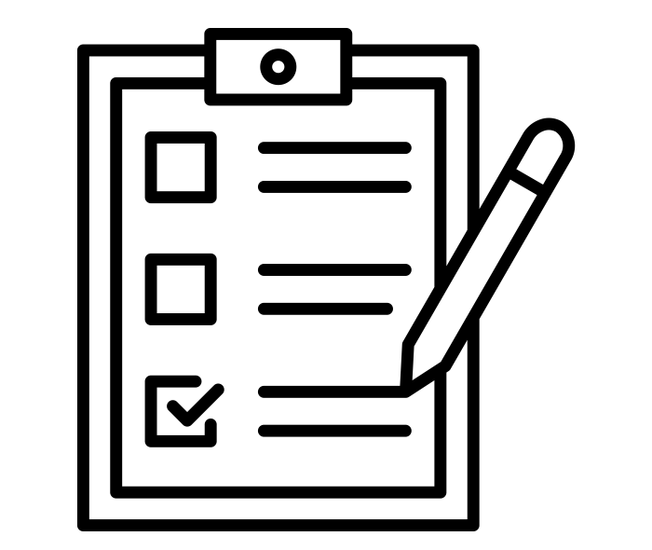


National Core Indicators
W&I Code §4571(h)(1)…
…requires that each regional center annually present data collected from NCI surveys at a public meeting of its governing board to assess the comparative performance of the regional center and identify needed improvements in services for consumers, including, but not limited to, case management services.
Share suggestions:
Please submit comments in Chat
ncifeedback@altaregional.org
National Core Indicators - CA Department of Developmental Services
The National Core Indicators (NCI) Surveys give individuals with intellectual/developmental disabilities (I/DD) and their families the opportunity to voluntarily and confidentially share their experiences on access to and use of regional center and community services.
The NCI Survey is used by the California Department of Developmental Services (DDS) to assess performances in services and supports provided to people with developmental disabilities.
Survey responses help the regional centers see what they are doing well and what they can improve.
Notes:
Mechelle
What is National Core Indicator survey aka NCI? Nationally validated assessment tool used by 48 of 50 states to measure and track performance. In California, Department of Developmental Services (DDS) contracts with the State Council on Developmental Disabilities to administer the survey.
What is the Purpose of NCI- opportunity for clients and families served to provide feedback. Surveys are voluntary and they are confidential meaning we only know that 414 Individuals who receive services participated in the survey. Sometimes SC receive calls from clients/families asking what is it? When surveys are sent to clients/ families we encourage them to participate in the survey.
Survey responses help the regional center see areas they are performing well in as well as areas that show where improvement is needed.
Welfare and Intuitions Code require regional centers to annually present the data in a public meeting format, during a Board meeting. We will be presenting data that was collected in 21-22 and comparing to data collected in 20-21. We will be submitting a report to the DDS on December 16th regarding our plans to address our priorities to improve areas of performance. Your input is needed! We have a dedicated email address for you to share your comments and feedback. You can also use the chat to share comments and feedback. Although we accept feedback year-round, we need your feedback by December 1st to be included in our report.
NCI raw data is posted on our website. (ACRC rep to drop link in chat)

Slide 3
Adult Family Survey
The Adult Family Survey is a written survey that is completed by families of an adult (age 18 and over) who lives with them and receives at least one service from a regional center, in addition to case management.
Child Family Survey
The Child Family Survey is a written survey that is completed by families of a child (ages 3-17 years old) who lives with them and receives at least one service from a regional center, in addition to case management.
Family Guardian Survey
The Family Guardian Survey is a written survey that is completed by families and conservators of individuals (age 18 and over) who live in a community placement setting, and receive at least one service from a regional center, in addition to case management.
Notes:
Jen - Today we will review results from 3 surveys conducted in Fiscal Year 21/22: (review each one). Historical trends are important. Our intent is to learn from this data and to explore areas where we can grow and improve.

Slide 4
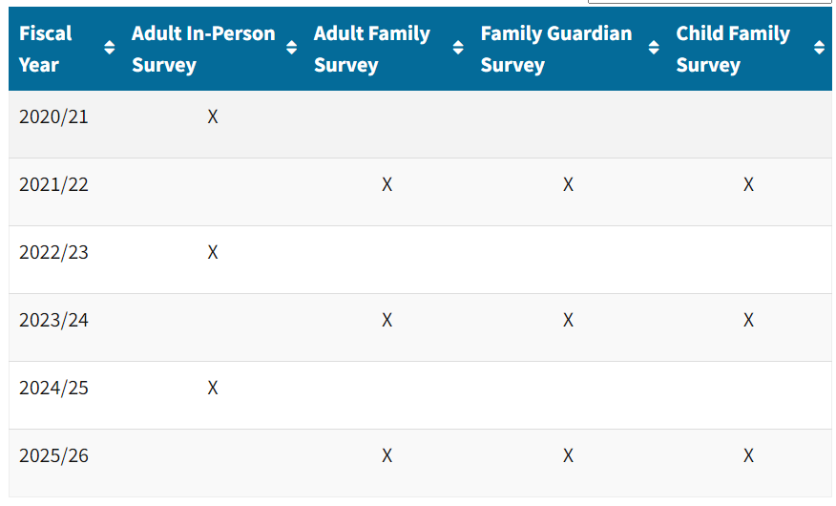
Review of Survey Cycle
Notes:
Jen on 10/27: These surveys are conducted in a particular cycle. Last year, we reported on data from the adult in-person survey. In Fiscal Year 21/22, the 3 surveys I just mentioned were conducted via mail (Adult Family Survey, Child Family Survey, and Family Guardian Survey). These same surveys were conducted 3 years ago, and we will compare the results from then to now.
George on 11/16
The Survey Cycle, as currently set, operates as follows: the Adult In-Person survey occurs on odd years while the remain three (Adult Family, Family Guardian and Child Family) occur on odd years.

Slide 5
20 Questions about the ability to connect and communicate in a way that people understand.
Access
Choice
5 Questions about the client/family’s voice being respected and directing decisions about service delivery.
Community
Participation
4-5 Questions about connections, relationships and doing things with others.
17-18 Questions about getting medical services when needed, like seeing a doctor, dentist, or psychiatrist. This section also includes questions about safety like preparing for emergencies and protection from abuse.
Health &
Safety
Information &
Planning
About 15 Questions about getting understandable information about resources and having the information included in the Individual Program Plan (IPP). Information can include things like housing, working, money, social/recreational activities.
Satisfaction
6-7 Questions about services being increased or decreased and results being positive or negative.
Key
+ : Positive connotation of statistic, more than 5% from the state average.
= : Neutral connotation, within 5% of the state average.
- : Negative connotation of statistic, more than 5% from the state average.
x̄ : Average or mean.
mode : Value that occurs most often.
Notes:
Herman

Slide 6
Adult Family Survey (AFS)
+
=
-
Access
Demographic Statistics
x̄ Age = 34
Dx Mode Int. Dis. = 70%
Dx 2nd Mode Autism = 38%
Preferred Lang. English = 89% Spanish = 3%
Household Income Over $75k = 24% $25k-50k = 18%
Sample Size: 384 Responses
Choice
Community
Participation
2021 / 2022
Health
Information &
Planning
Satisfaction
Notes:
Elijah: The Adult Family Survey is a written survey that is completed by families of an adult (age 18 and over) who lives with them and receives at least one service from a regional center, in addition to case management.
Leaning Pos: Access, Health and Information Planning. Some negative lean in Satisfaction and Access. Review demo stats.

Slide 7
ACCESS
Are you or your family member able to contact the case manager/service coordinator when you want?
54%
Always
ACRC
48%
CA
If your support workers and/or service coordinator do not speak to you in your preferred language is a translator provided when needed?
22%
Always
ACRC
31%
CA
Notes:
Elijah: Data highlighted: Ease of ability to contact SC or manager: above 5% threshold. Ease of access to translation services: below 5% threshold, although due to increase of average overtime in state.
-Documentation translation, iPad Translation Initiative, bilingual employee stiped and community listening sessions.
Much like the State of California, ACRC’s clients, families and employees are diverse. ACRC recognizes the critical importance of bridging gaps in service across our agency. This means ensuring that our employees offer a wide array of languages spoken, and that we have employees who understand the cultural diversity of clients served. ACRC has 97 staff who are fluent in a second language with 16% of staff who are bilingual to meet the needs of 11% of our clients who are also bilingual.
ACRC participating in the RCPM Language Access ensures & Linguistic Diversity:

Slide 8
COMMUNITY PARTICIPATION
Does your family member do things in the community?
77%
Yes
ACRC
74%
CA
For your family member, what makes it hard to do things in the community? Check all that apply:
Notes:
Elijah-Notes: 77% of the ACRC respondents noted that they actively participated in their local community, with nearly 35% noting there was no barrier to doing so. Considering barriers still, 20% noted that cost was a barrier. This lends itself to the continued value of building high-quality day programs and ensuring our population has information about public benefits to help mitigate this barrier. Note: multiple choice.
Herman
ACRC recognized area of community participation, social rec, every IPP includes ability to fund soc rec.

Slide 9
+
=
-
Access
Demographic Statistics
x̄ Age = 9
Dx Mode Autism = 78%
Dx 2nd Mode Int. Dis = 31%
Preferred Lang. English = 80% Spanish = 5%
Household Income Over $75k = 33% $50k-75k = 18%
Sample Size: 232 Responses
Child Family Survey(CFS)
Choice
Community
Participation
2021 / 2022
Health
Information &
Planning
Satisfaction
Notes:
Elijah
The Child Family Survey is a written survey that is completed by families of a child (ages 3-17 years old) who lives with them and receives at least one service from a regional center, in addition to case management.

Slide 10
HEALTH
Can your child get mental or behavioral health supports when needed?
30%
Always
ACRC
27%
CA
Can your child see a primary care provider (doctor, registered nurse, etc.) when needed?
77%
Always
ACRC
72%
CA
Notes:
Elijah: within 5% parameter of state average for MH supports. Above average for access to primary care. Reflects the positive overarching lean in ACRC data to positive Health outcomes as reflected on previous slide.
Jen - We attribute the positive results in this measure partly to our relationships with our Managed Medi-Cal Plan partners. We meet quarterly with managed care liaisons within each plan and reach out to each other as needed. An understanding of our systems and processes benefits our shared clients and patients. Additionally, we have partnerships with the UC David MIND Institute, UC Davis Health, Sutter Health, and others. Our partnerships with county child welfare agencies and school districts allows for collaboration and identification of service gaps and needs. ACRC’s Strategic Plan encompasses Strategic Focus Area under the category of Client and Family Support. Within this focus area, goals include helping to facilitate the identification of community resources, and to conduct informational presentations to connect with our provider networks. One of our vendored providers, Level Up NorCal specializes in assisting families who experience linguistic and cultural barriers in navigating healthcare and other services. These initiatives help to improve awareness and access. Jen gives example

Slide 11
INFORMATION & PLANNING
CA 21/22
Does your regional center keep you informed, in your preferred language, about programs or services it offers?
23%
Always
ACRC
31%
CA
ACRC
Do you need help planning for your child’s future in any of the following areas? Check all that apply:
Do you have enough information about other public services your family can get (e.g., food stamps, SSI, housing subsidies, etc.)?
Notes:
Elijah
Enough info about generic services, 44% positive vs. state 37%. Overarching theme that our system needs to be an access point to information in all preferred languages as is reflected by the language deficit reflected here. Also notable is that the top 2 areas of information sought are focuses often thought to be outside the scope of public welfare: notably recreation and social/relationships.
Herman
-Documentation translation, iPad Translation Initiative, bilingual employee stiped and community listening sessions.
Jen
ACRC is fortunate to have several specialist positions on our team to provide additional support to the clients and families we serve. These positions help support our Strategic Plan and focus area of Client and Family Support. Some include Education Support Manager, Dental Coordinator, Housing Specialist, Data Scientist, Cultural Specialist, Client Employment Specialist, Deaf and Hard of Hearing Specialist, Health and Safety Waiver Specialist, and a Community Services and Supports Specialist dedicated to social recreation activities. All of these positions and employees help to aid and support clients and families in planning for services. Jen gives an example.

Slide 12
+
=
-
Access
Demographic Statistics
x̄ Age = 44
Dx Mode Int. Dis = 68%
Dx 2nd Mode Autism = 35%
Preferred Lang. English = 96% ASL = 2%
Household Income Over $75k = 28% $50k-75k = 15%
Sample Size: 331 Responses
No Guardian/Uncons.: 45%
Limited/Full Guardian: 49%
Family Guardian Survey(FSG)
Choice
Community
Participation
2021 / 2022
Health
Information &
Planning
Satisfaction
Notes:
Elijah
Review demo statistics.
Above in Community participation, health and information & planning. Below in Access, health and information planning.
The Family Guardian Survey is a written survey that is completed by families and conservators of individuals (age 18 and over) who live in a community placement setting, and receive at least one service from a regional center, in addition to case management. Slight positive lean in Community participation, Health and Information Planning although largely within average for the state, with negative lean in Access, Health and Information as well.
Herman covers initiatives.

Slide 13
SATISFACTION & ACCESS
CA 19/20
CA 21/22
Overall, are you satisfied with the services and supports your family member currently receives?
83%
Always
or Usually
ACRC
85%
CA
ACRC
Do your family member’s support workers change too often? Is there too much “turnover” of support workers?
35%
Yes
ACRC
27%
CA
Notes:
Average satisfaction with supports received but below average response to turnover and it’s impacts. Questions remain about the implication of the questions framing around “support workers” and whether they refer to regional center staff, direct support staff, or both but we are examining this data through the lens of assuming this is also a reflection of our struggles with retention and responding as such.
Herman covers - Hiring initiative w/ referral program and referral bonuses. Retention; Recruitment Efforts; DSP Collab

Slide 14
CHOICE
Does the agency providing residential services to your family member involve them in important decisions?
60%
Always
or Usually
ACRC
58%
CA
Removal of N/A
74%
Always
or Usually
ACRC
71%
CA
Notes:
Elijah
*Review question.
Inclusion of choice as a category and this question specifically is to highlight two things: the necessity to touch on each area of focus, despite all the responses for ACRC in the choice category being within the state average. Additionally, it’s to provide clarification for this question (and similar questions) specifically.
60% of respondents noted that they were involved in important decisions either always or most of the time. This is within state average but lower than expected. That said, this statistic is a bit misleading as it includes respondents who receive no residential services. When corrected for, the more accurate statistic is 74% of families that receive residential services/always or usually category.
*Technology initiative to better communicate with families
Mechelle
One of ACRCs core values is to promote the self-sufficiency of clients and do this in a manner that values, respects and honors individual choice, self-determination, and self-advocacy. There are to initiatives that I will highlight:
1) With the passage of AB1663 (Law supporting Supported Decision Making as a least restrictive option to conservatorship) ACRC has been meeting with a workgroup of clients from our Client Advisory Committee, representatives from the State Council on Developmental Disabilities and ACRC client advocates to discuss resources and develop training material for staff and the community. SDM is a process that allows people with disabilities to receive support from individuals they choose to help them make life decisions. This is a new area for clients to exercise choice and decision making. ACRCs workgroup has been meeting monthly since May 2023.
2) Because California receives funding from the Federal Medicaid Program, new Home and Community Based Services (HCBS) new rules went into effect in March of this year. The new rules illuminate choice and person-centered planning. The goal of HCBS is to ensure that individuals receive services in settings that are integrated in and have access to the greater community. The regulations also ensure that individuals have a free choice of where they live and who provides services to them, and that individual rights and freedoms are not restricted. The HCBS program allows the state of California to be reimbursed for some of the funds the state expends for services to people with developmental disabilities. These include services like residential care homes, day programs, employment programs and other community based congregate services.

Slide 15
Access
Positive
43 of 195 22.05%
Neutral
137 of 195 70.25%
Negative
15 of 195 7.69%
ACRC
NCI Results
Summary
Choice
Community
Participation
2021 / 2022
Health
Information &
Planning
Satisfaction
Notes:
Elijah - All 3 survey results merged for overall view. Average or positive connotation

Slide 16
Contributors
Mechelle Johnson, Director of Client Services
mjohnson@altaregional.org
(916) 978-6653
Jennifer Bloom, Director of Client Services
jbloom@altaregional.org
(916) 978-6572
Elijah Jenkins, Data Scientist
ejenkins@altaregional.org
(916) 978-6380
Herman Kothe, Training Manager
hkothe@altaregional.org
(916) 978-6506
ncifeedback@altaregional.org

